Slide 1


Slide 2

Scope
Analysis of Historical Pokémon Video Game Sales
Deep dive into the Relationship between Perceived Quality Decline and Total Units across title releases.
Breakdown of Factors Influencing Game Sales:
Game Type–Core RPG vs Core Upgrade vs Core Remake vs Spin-Off
Release Gaps
Console Sales
Comparative analysis of Core RPG Titles and their respective Remakes
Predictive Model for forecasting sales of upcoming Pokemon games:
Legends Z-A, and the unannounced Generation 10 Games

Slide 3
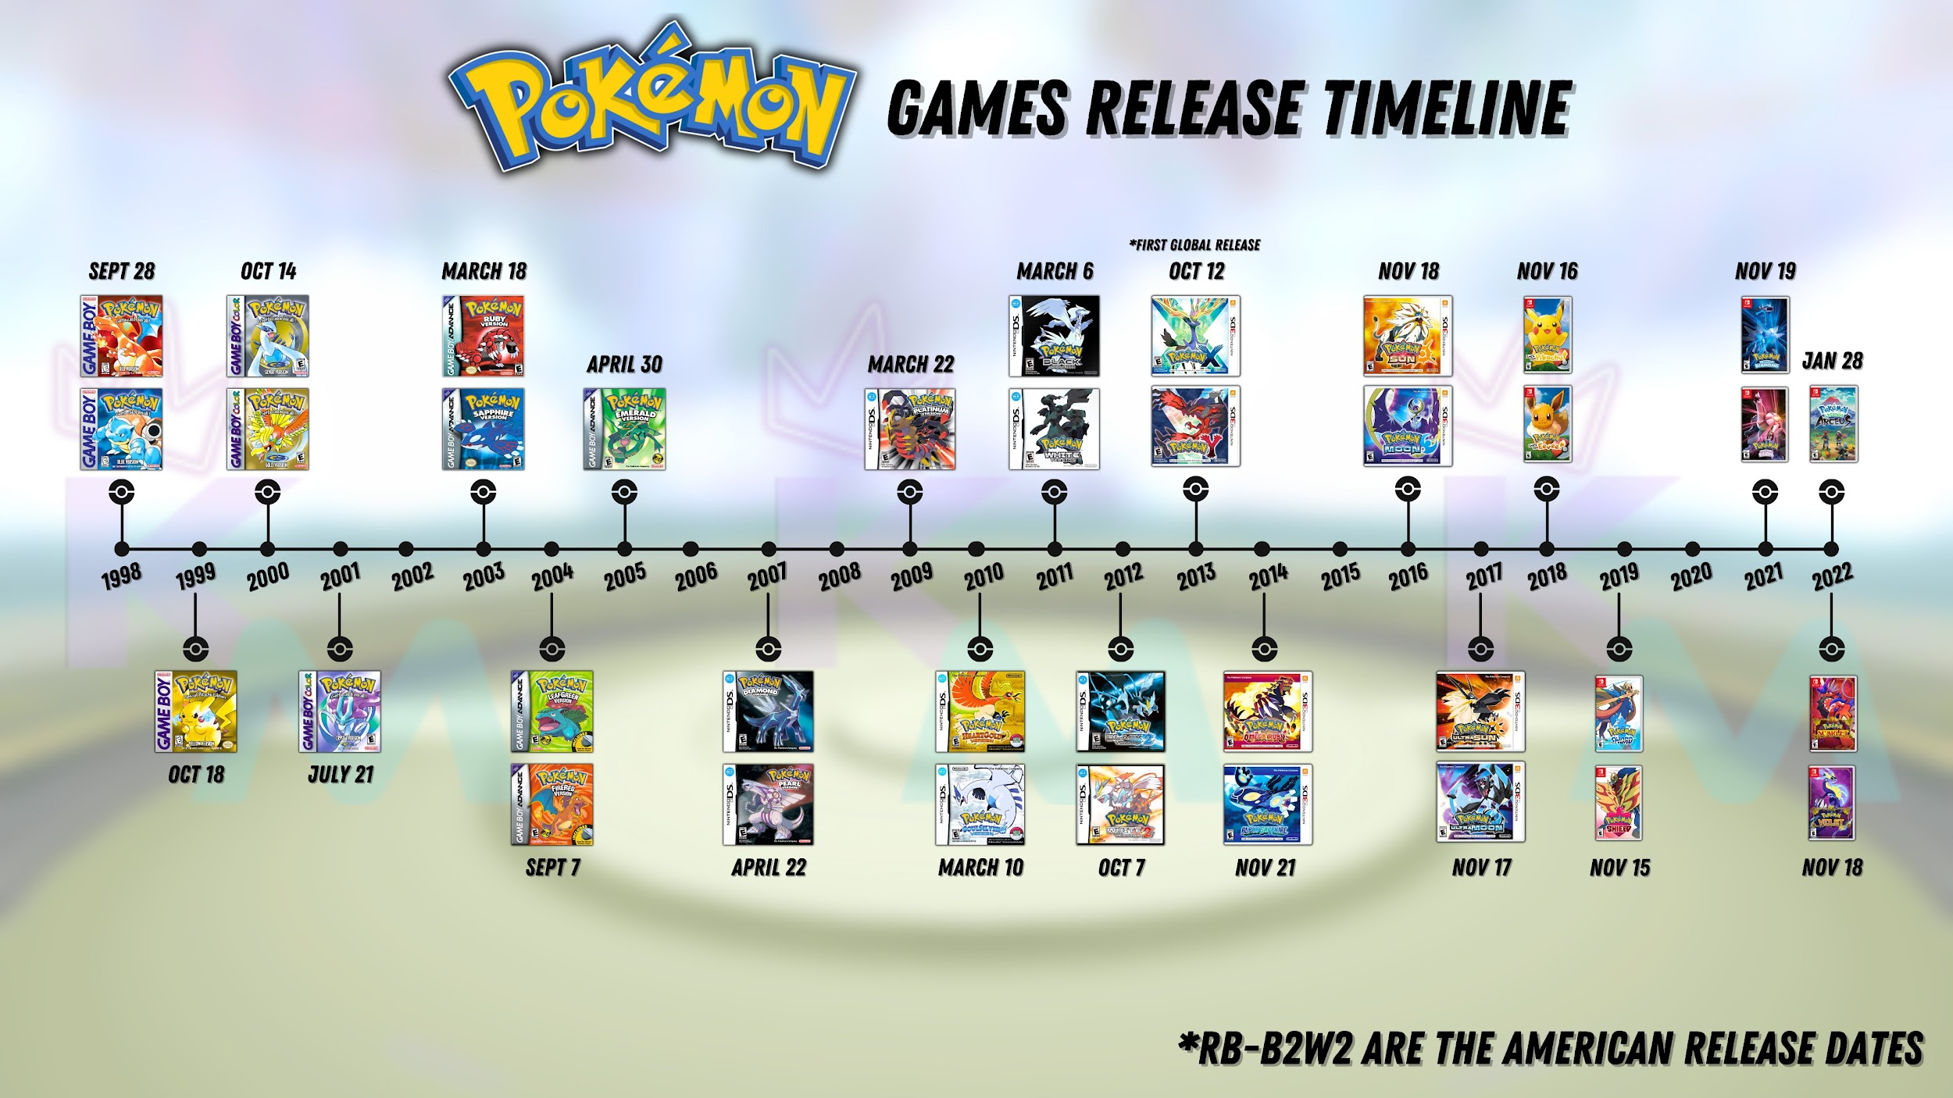
Credit: @KinglyMajesty on x

Slide 4









Core RPG
Main Series Role-Playing Games
1998
2003
2011
2016
2022
2000
2007
2013
2019

Slide 5






Core Upgrade
Definitive Edition of Each Generation of Core RPGs

Slide 6





Core Remake
Remakes of Main Series Role-Playing Games
2004
2018
2010
2014
2021
1998
2000
2003
2007

Slide 7



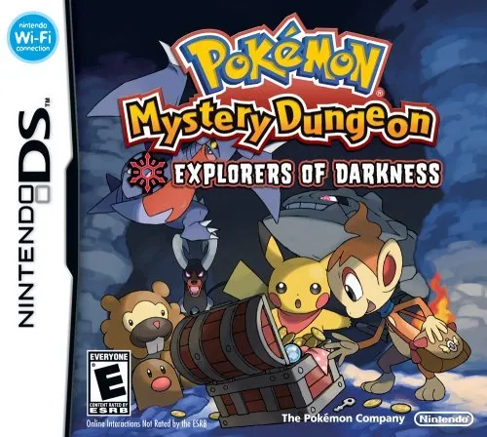

Spin-Off
Non-RPG Game Releases

Slide 8
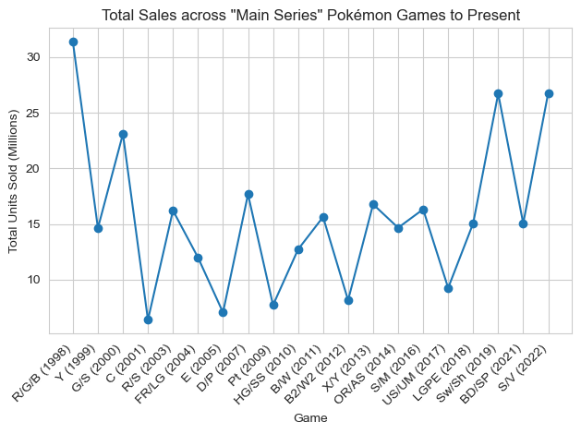


Slide 9
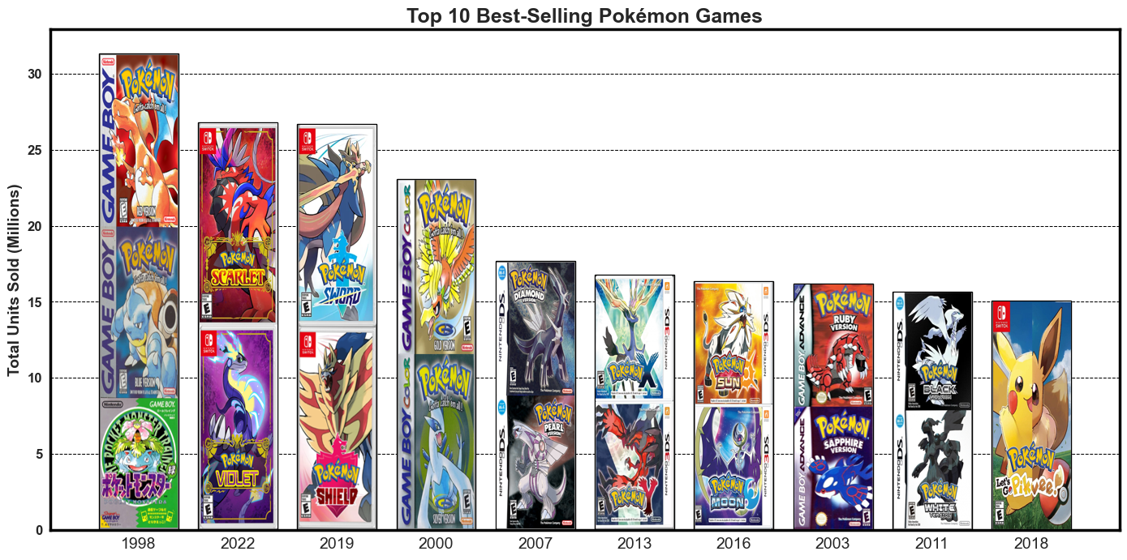

Slide 10
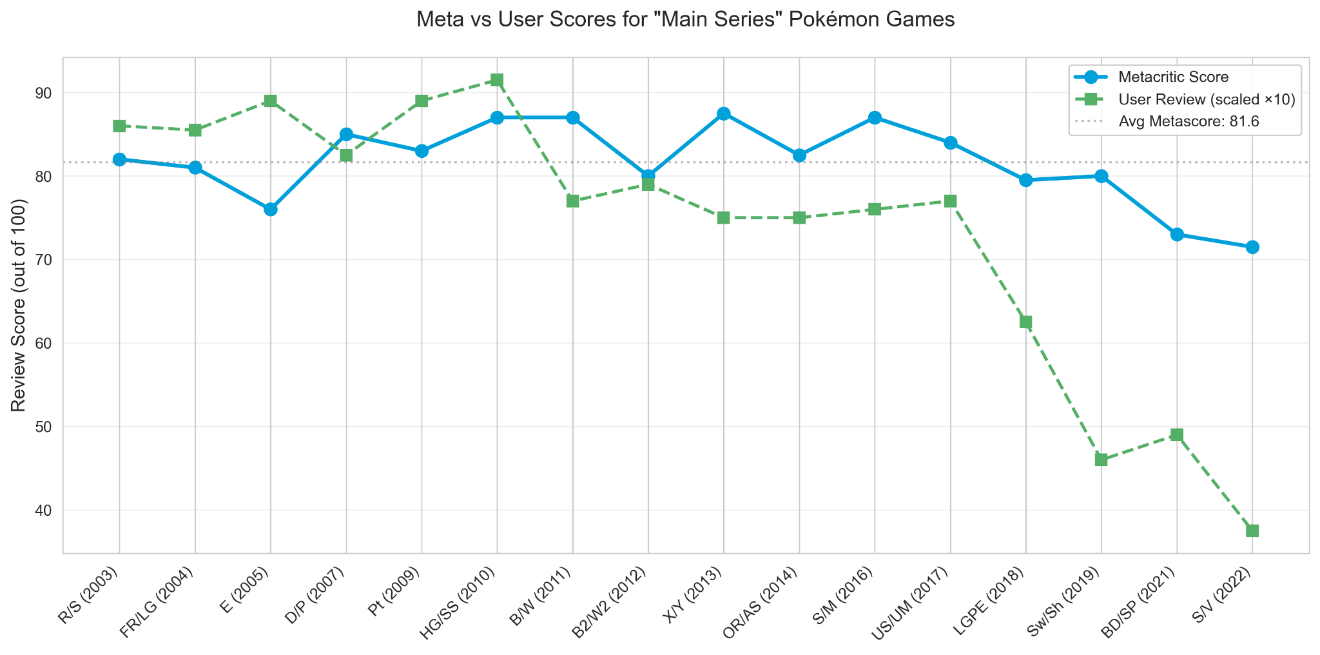


Slide 11
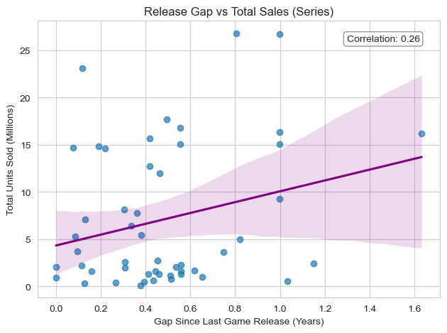


Slide 12

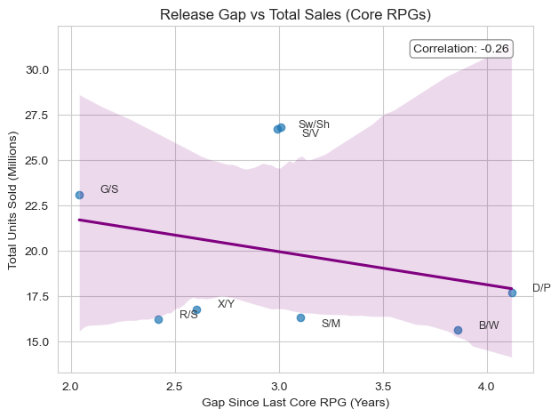
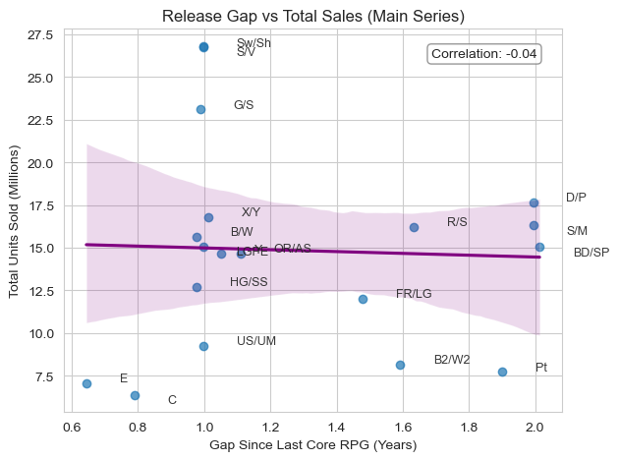


Slide 13


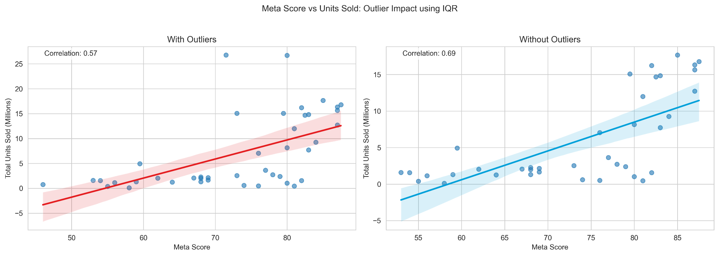

Slide 14
